Slide 1


Politics and Programming: Analyzing a Correlation Between Open-Source Software Contribution and Democratically-Driven Communities
Matthew Kenneth Peterson
Student ID #3719754 | mpeters9@unb.ca

Slide 2
What is Open-Source Software (OSS)?
"Open-source software is code that is designed to be publicly accessible—anyone can see, modify, and distribute the code as they see fit."
"Open-source software is developed in a decentralized and collaborative way, relying on peer review and community production. Open-source software is developed by communities, rather than a single author or company."
-Red Hat
https://www.redhat.com/en/topics/open-source/what-is-open-source

Slide 3




A Thriving Community
Open-source software (OSS) development encourages study and usage by a wide range of individuals and industries
Encourages collaboration and forms communities
Many volunteer their time and energy towards OSS and expect little in return

Slide 4

Societal Implications?
2021 study showed that there were many countries which far exceeded others in open-source contributions per capita
Established a positive correlation between gross national income (GNI) and open-source contributions per capita
J. Wachs, M. Nitecki, W. Schueller, A. Polleres. "The Geography of Open Source Software: Evidence from GitHub." Technological Forecasting and Social Change (2022): https://www.sciencedirect.com/science/article/pii/S0040162522000105

Slide 5

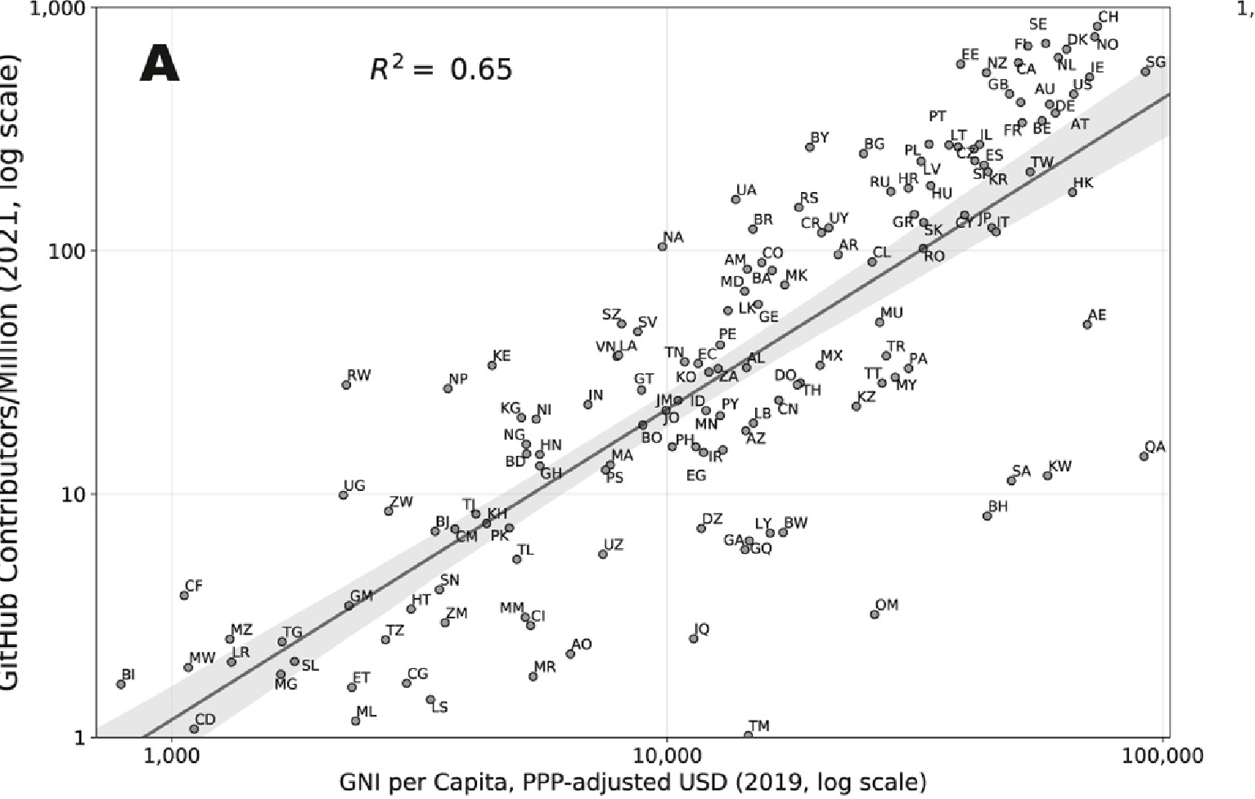
Sample figure from the study showing correlation between GitHub
contributions and gross national income (GNI).

Slide 6

Hypothesis
A willingness to contribute to open-source communities may be indicative of willingness to participate in democratic electoral processes

Slide 7
Data Sets
GitHub Open-Source Contribution Regions Study
https://github.com/johanneswachs/OSS_Geography_Data
Economist Intelligence Unit's Democracy Index
https://github.com/owid/notebooks/tree/main/BastianHerre/democracy/datasets/cleaned

Slide 8
Metrics
Democracy is multifaceted! Three metrics chosen for data analysis:
Overall political participation index. Describes the actual participation by citizens in federal elections.
Democratic culture index. Extent to which a country's citizens prefer democratic institutions over non-democratic ones.
Free and fair election index. This describes the extent to which a country hosts free and fair elections for its citizens.

Slide 9
Expected Result
Expect a positive correlation with political participation, as it describes likelihood of action.
Expect a positive correlation with political freedom, as it outlines effects of restrictions against political action.
Unsure over correlation between democratic culture. More exploratory than investigative.

Slide 10
Methodology
Order-2 regression, plotted using Seaborn's "regplot" function
Create and score the predictive performance of the data using Scikit-learn's linear regression scoring
Training/testing data selected randomly over 1000 iterations to find average predictive performance (R²) and average P-value

Slide 11
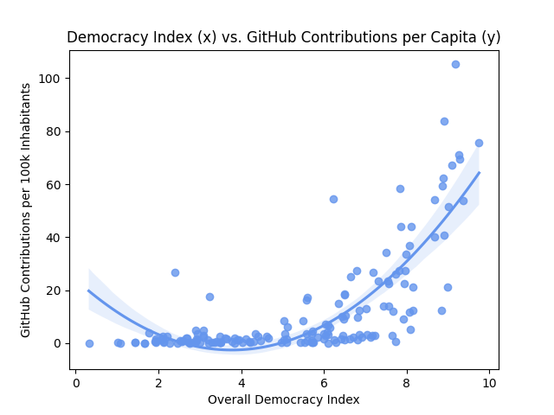
Results
Predictive Performance:
R² = 0.3824
P = 7.66x10⁻²¹

Slide 12
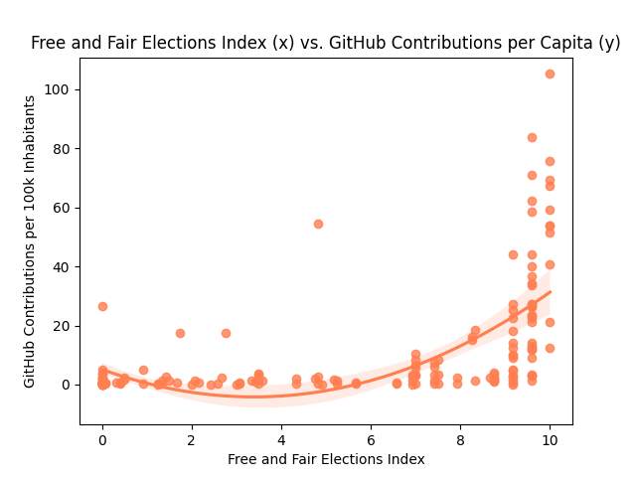
Results
Predictive Performance:
R² = 0.2079
P = 2.05x10⁻¹¹

Slide 13
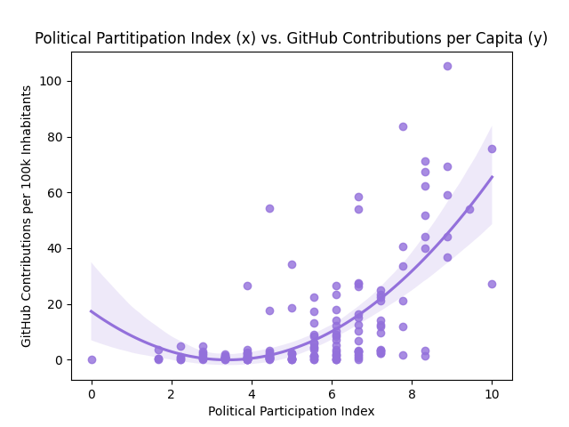
Results
Predictive Performance:
R² = 0.3125
P = 3.79x10⁻¹⁷

Slide 14
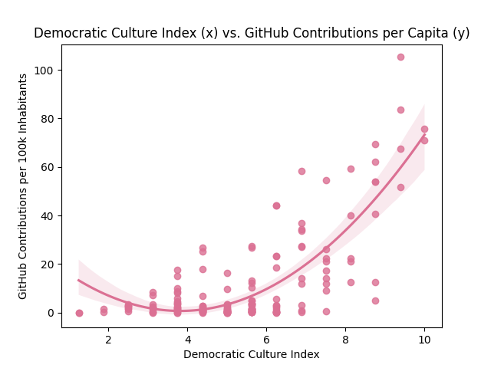
Results
Predictive Performance:
R² = 0.3958
P = 2.57x10⁻²²

Slide 15
Conclusion & Discussion
Found a statistically significant (p < 0.05) positive correlation between a region's overall democratic participation in all studied regards, and its GitHub contributions per capita for the year 2021
Regardless, this does not paint a full picture. Possible further analysis for greater detail: - Introduce more predictors (i.e. access to technology per region) - Compare with democracy indexes from alternative organizations - Collect GitHub data for years other than 2021

Slide 16
Thank you.
GitHub: https://github.com/MKP157/CS2704-Project

